Slide 1

SENTIMENT ANALYSIS

Slide 2
OUTLINE
Introduction
Motivation
Proposed system
Support Vector Machines
How do we proceed?
Training
Run Time
Demo
Future Scope
Appendix

Slide 3

What is Sentiment Analysis?
Classify the polarity of the text as positive or negative
Really long battery life.
Doesn’t work properly
in low light.
[ Sentiment-positive ]
[ Sentiment-negative ]

Slide 4

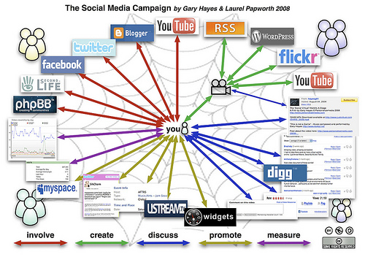


MOTIVATION

Slide 5
Why Sentiment Analysis?
Movie: is this review positive or negative?
Products: What do people think about the new iPhone?
Public Sentiment: how is the customer sentiment? Is the despair increasing?
Politics: What do people think about the party or candidate or the issue?
Prediction: Predict market trends or election results from the sentiment

Slide 6
PROPOSED SYSTEM
Polarity of many words is domain specific
Eg. ‘long’
“long battery life”
“long shutter lag”
Domain specific lexicons improve sentiment accuracy
Aim to first identify the aspect under consideration and then the polarity.
Entire customer review is broken into subsentences and each subsentence goes through aspect identification and polarity determination.
Use SVM (LibSVM) for both classifications.
We identified 12 distinct aspects and training data of around 1850 reviews was collected and manually annotated with polarity and aspect.

Slide 7
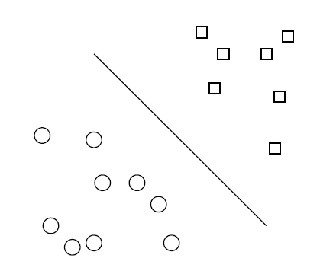
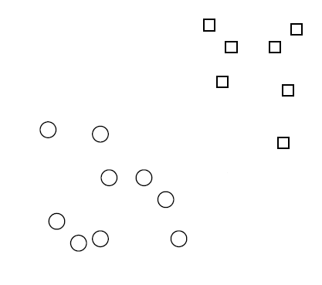
SUPPORT VECTOR MACHINES
2 class training data

Slide 8
SUPPORT VECTOR MACHINES
2 class training data
Decision boundary –
linear separator

Slide 9
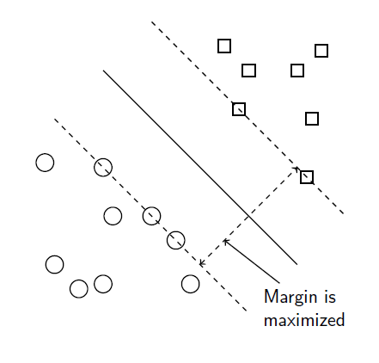
SUPPORT VECTOR MACHINES
2 class training data
Decision boundary –
linear separator
Criterion: being maximally far away from any data point

Slide 10
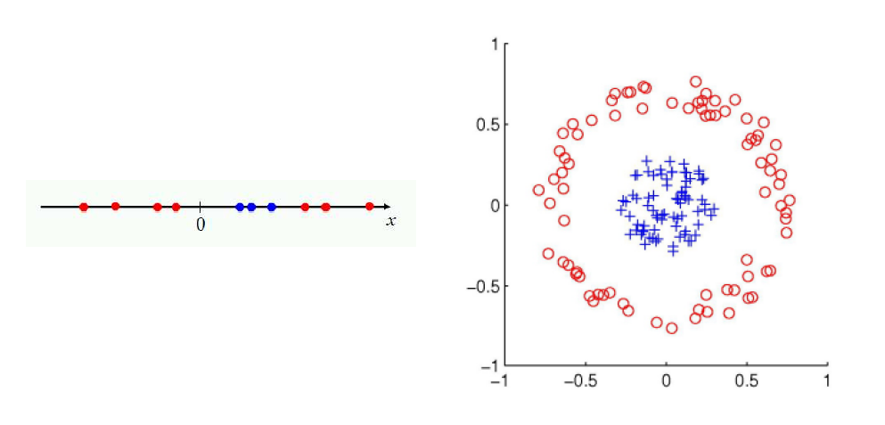
But What if the data is not linearly separable?

Slide 11
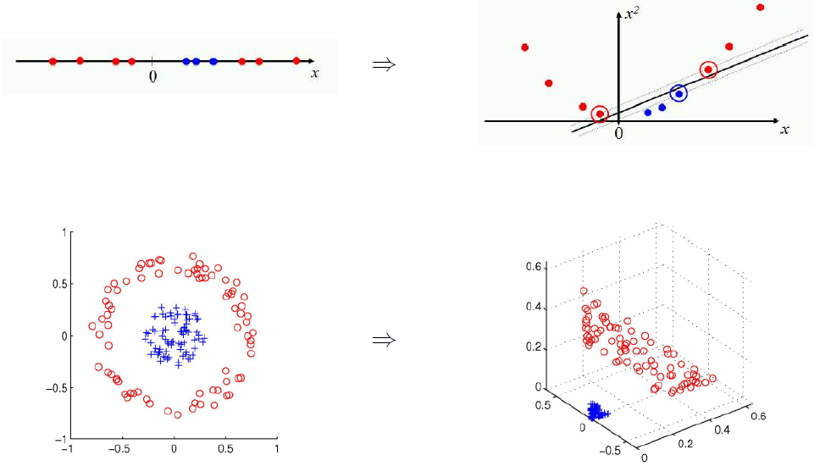
Map the data to space where it is.. (Kernel Trick)

Slide 12
How do we proceed?
Before run time,
Train for aspect classification -> Model for aspect
Train for polarity identification for each aspect -> Model for polarity of each aspect
At run time,
User Review broken into subsentences
identify aspect of each subsentence
combine adjacent subsentences talking about same aspect
identify polarity of each part
calculate overall score for review

Slide 13
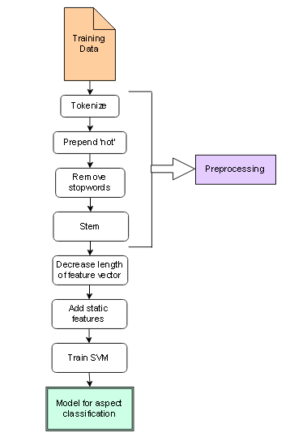
TRAINING
Training Aspect Classifier
Don’t love the sound quality.
Tokenize
Do n’t love the sound quality
Prepend not
Do not_love the sound quality
Remove stopwords
Not_love sound quality
Stem
Not_love sound qual
Decrease length of feature vector * = remove all
lexicon that appear in multiple reviews of
different aspects with overall frequency <4 or >30.

Slide 14
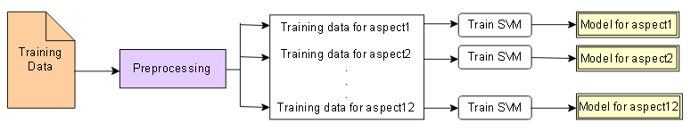
2. Training polarity classification model for each aspect
The feature vector for polarity identification consists of all the lexicons that appear in reviews for that aspects after preprocessing
Thus, we have 1 model for aspect classification and n models for polarity identification where, n= number of aspects.

Slide 15
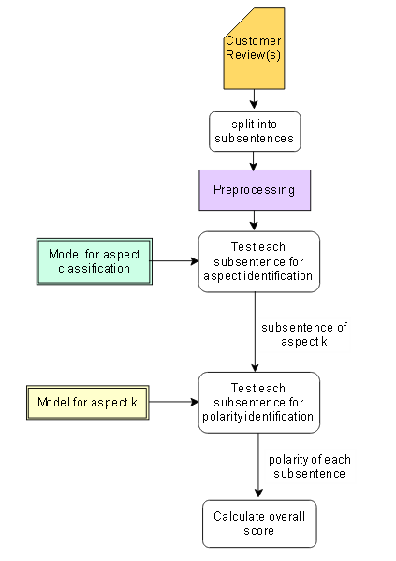
Run Time

Slide 16
Running,
It runs for a long time without charging. The camera works great. It takes superb pictures even in dim light, but it lags a bit.
break into subsentences
[‘It runs for a long time without charging’, ’The camera works great’, ’It takes superb pictures even in dim light’, ’but it lags a bit.’]
preprocess
[‘run long tim without charg ’, ’ camer work gre’, ’tak superb pict ev dim light ’, ’ lag bit ’]
combine =>[battery, camera, camera, speed]
‘run long tim without charg ’, ’ camer work gre tak superb pict ev dim light‘, ’ lag bit ’]
=>[positive, positive, negative]

Slide 17
It runs for a long time without charging. The camera works great. It takes superb pictures even in dim light, but it lags a bit.
Output:
[Battery, Camera, Speed]
[Positive, Positive, Negative]
Score = ((1*N_battery)+(1*N_camera)+(-1*N_speed))/(N_total)
Intuitively, if more reviews talk about a particular aspect, that aspect is relatively more important for the users.

Slide 18
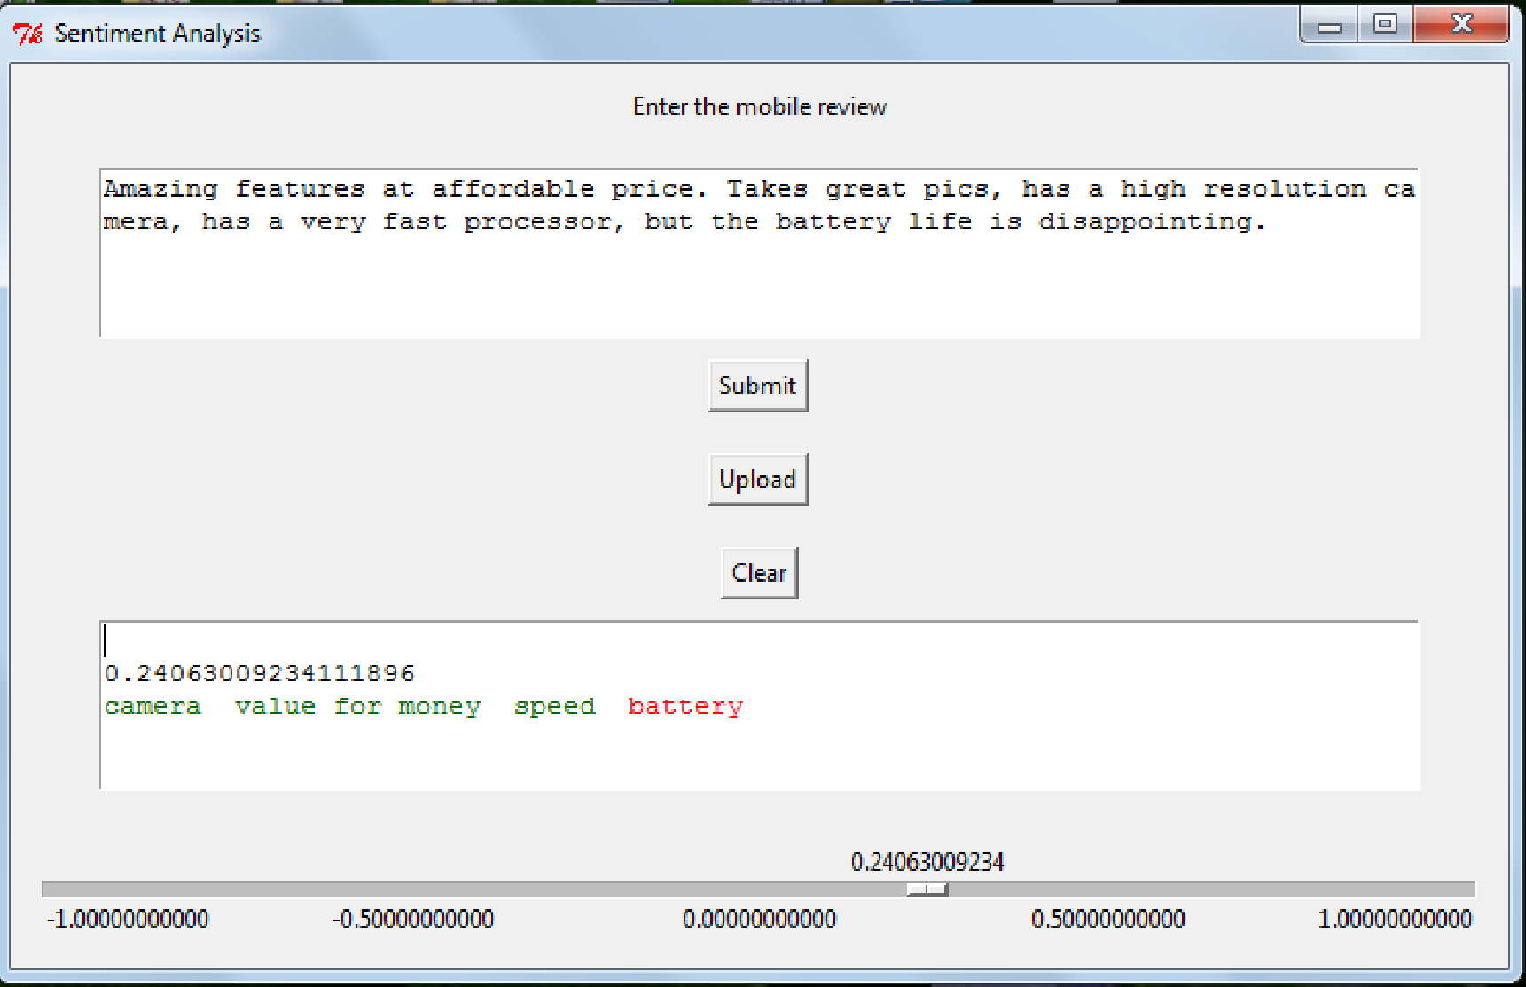
DEMO

Slide 19
FUTURE SCOPE
A crawler may be added to the application and the product name can be taken as input from user. The crawler would obtain the customer reviews that can be used for testing data.
Ranking for each aspect can be incorporated i.e. we may identify ‘how good’ or ‘how bad’ the camera is.

Slide 20
APPENDIX
TOKENIZE
I don’t like the camera, and the phone is very bulky.
‘I do n’t love the sound quality’, ‘and the phone is very bulky’
The sentence is split and parts like n’t and not are separated.

Slide 21
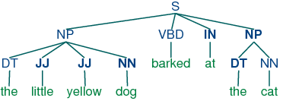
POS TAGGING AND PREPEND ‘NOT’
“The little yellow dog barked at the cat”
Once a word like ‘not’ or ‘n’t’ is found then we prepend it to the next first coming verb or adjective.

Slide 22
STOP WORDS
a
about
above
after
again
against
all
am
an
and
any
are
aren't
as
at
be
because
Been
Being
i
i'd
i'll
i'm
i've
if
in
into
is
to
it
it's
its
itself
let's
me
more
most
my
than
that
that's
the
their
theirs
them
themselves
then
there
there's
these
they
they'd
they'll
they're
this
those
through
Words that would not contribute much to aspect or polarity classification.

Slide 23
STEMMING
“I really liked this movie!”
“I really like this movie!”
Pathetic, pathetically -> pathet
watching, watched -> watch

Slide 24
THANK YOU!!

